Slide 1
PREDICTING HABITABLE EXOPLANETS IN DIFFERENT STAR-SYSTEM USING DEEP LEARNING
Yash Patel
MIT2021090

Slide 2
Table of contents:
Motivation
Objective
Timeline for the proposed work
Introduction
Related works
Challenges and research gaps
Problem formulation
Expected/Proposed solution
Dataset description
Data pre-processing
Result
Concluding remarks
References

Slide 3
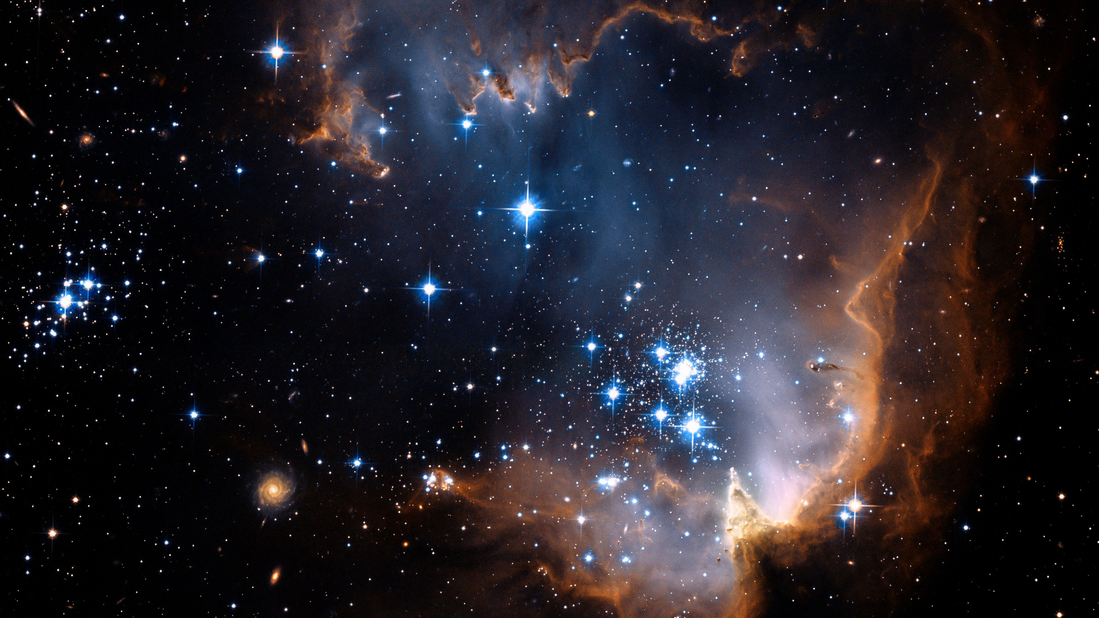
1. Motivation :
Mankind has been looking up at the stars for centuries, wondering what lies out there in deep space, and if there are other civilizations like ours that exists.
Multiple missions data is needed to be combined.
Handling this large amount of data.
Well-designed user interface to get the desired output.

Slide 4
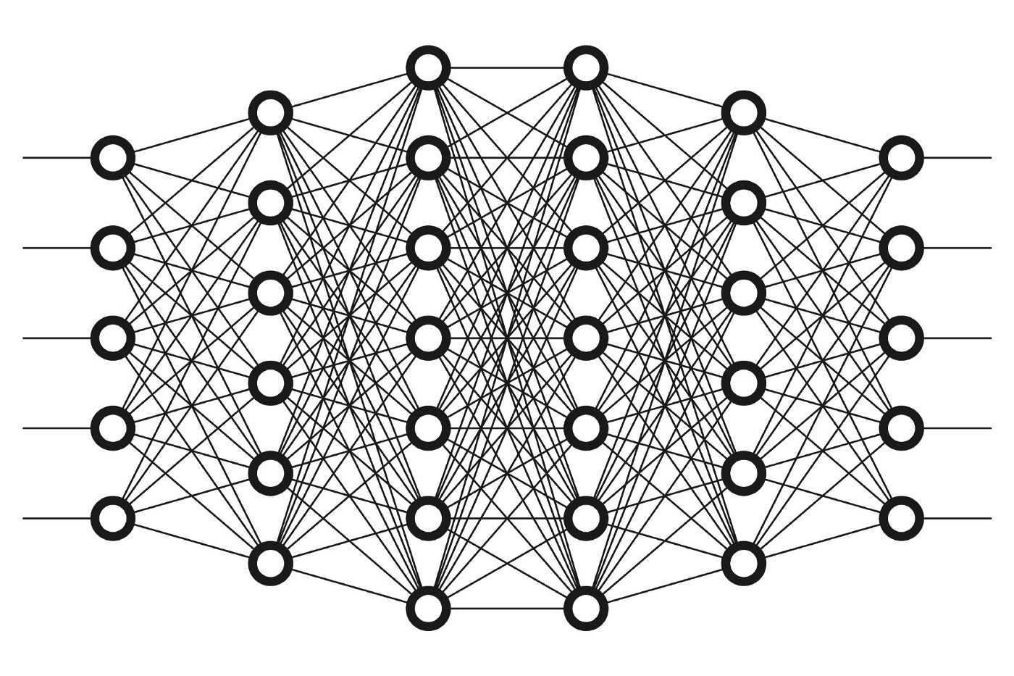
2. Objective :
Make use of concept of Artificial Neural Networks from deep learning
Better efficiency in our prediction model.
Handful of work done in this field using deep learning models.
With so many missions now completed and tones of data collected by them.
Future missions like James Webb Space Telescope and PLAnetary Transits and Oscillations of stars (PLATO).
Therefore, this is the right time to explore deep learning which requires huge amount of data in the field of astronomy.

Slide 5
3. Timeline :
Time Period | Description
1st Feb to 28th Feb | Project selection, Research work, literature survey, Report making.
1st March to 15th April | Data pre-processing, data extraction, parameter selection.
16th April to 30 May | Model building, training and testing, hyperparameter optimization, Outcomes.

Slide 6
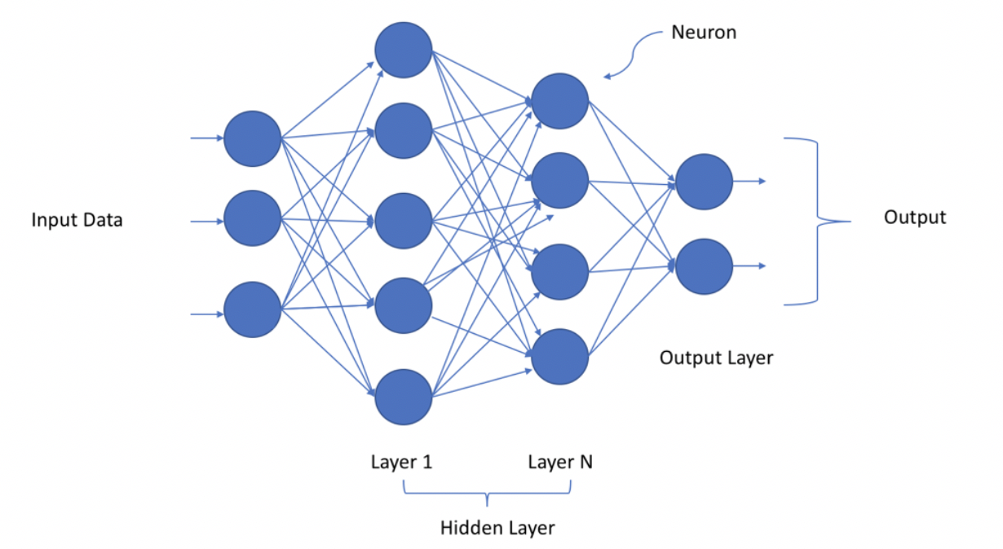
4. Introduction :
The observable universe is around 46.5 billion light years
200 billion to 2 trillion cosmic systems
Cosmologists assessed that there are about 250±150 billion stars in the Milky Way alone
Stars like the Sun make up approximately 10 percent of all-stars for example around 20±15 billion stars.
In the mid-90s, the researcher’s recognized a few objects, called exoplanets, utilizing Doppler spectroscopy, at times called the spiral speed technique, and ordinarily known as the wobble strategy.
Objective of this project work is to make use of concept of Artificial Neural Networks from deep learning.
Our focus will be on achieving the better efficiency in our prediction model as compared to previously build models in this field.

Slide 7
5. Related Works:
Research Work | Methodology | Approach | Limitations | Future Work
Classifying Exoplanets as Potentially Habitable Using Machine Learning. [Karan Hora] | Six supervised learning algorithms for the classification: 2 Decision Tree, CART and random forest, Logistic regression, Feed-Forward Neural Network, SVM and Naïve Bayes. | Used Habitable Exoplanets Catalog contains 1,943 exoplanets out of which only 31 are categorized as potentially habitable. Dividing the data in the ratio of 70:30 for training and testing. | Only handful of exoplanet data containing only 1943 datapoints. Large gap in the ratio of potential habitable and non-habitable exoplanets i.e., 1943:31 only. | Models can be further optimized as the available data from various missions increases in size.
Finding Habitable Exo Planets Using Boosting Algorithm. [Md. Mashfiq Rahman] | Used 2 classification-based machine learning algorithm i.e., KNN classifier and Decision tree classifier. Also boosting algorithms are used to increase efficiency of above algorithms namely Ada boosting and XGA (extreme gradient boosting) algorithm. | Dataset of 3,874 known exoplanets is used. Which is divided in 80:20 ration for training and testing. 80% of training data is further divided into 70:30 ratio for validation out of which 70% is used for creating model and remaining 30 to fit the model. | Models are built only on limited i.e., 5 parameters: Habitability Zone, period, mass and radius, metallicity and eccentricity. | As size of dataset increases efficiency of models will also increase. And set an unsupervised program to collect data continuously and analyze it.

Slide 8
Predicting habitable exoplanets from NASA's Kepler mission data using Machine Learning. [Rajeev Misra] | Used SVM model along with forward feature selection and reverse feature elimination algorithms. | Initially 2,373 planetary data was used in the ratio of 50:20:30 for training, dev and testing. And later model was deployed on whole dataset of 9,564 planets for prediction. | 14 stellar and planetary parameters were used in the model out of 140. Although not all of them affect the result but other parameters such as few optical parameters could have been considered. | With more upcoming space telescope missions as the available data increases so will the efficiency of machine learning models.
CEESA meets machine learning: A Constant Elasticity Earth Similarity Approach to habitability and classification of exoplanets. [S. Basak, S. Mathur] | Developed new model namely CEESA which uses parameters radius, density, surface temperature, escape velocity and eccentricity to calculate the habitability score of exoplanets. | This model overcame the drawback of ‘0’ values in the dataset by using models like KNN to further optimize the existing models like CD-HPF. ANN and fuzzy NN were also experimented. | ## No information about dataset provided. | With increase in available data efficacy of the model will also increase.
Habitability classification of exoplanets: a machine learning insight. [S Basak, A Mathur] | Investigate the existing machine learning algorithms, such as Naive Bayes, Linear Discriminant Analysis, Support Vector Machine, KNN, Decision Tree, Random Forest and XGBoost. Exploration of neural network models like RWNN, GAN and fusion net. | Machine Learning algorithm are investigated on the dataset containing 3,800 data points of extrasolar objects. And then neural network models are used with activation function used being Leaky RELU. | Limited dataset of 3,800 objects from PHL-EC catalogue. | As available dataset of these exoplanets increases with more upcoming future missions’ efficiency and working of other algorithms can be tested.

Slide 9
Exoplanet Hunting in Deep Space with Machine Learning. [Shivam P Singh] | The dataset used in this project was obtained from National Aeronautics and Space Administration, "Kepler and K2”. Machine learning algorithms used for prediction are KNN, SVM, Linear Discriminant Analysis (LDA), Naïve Bayes, Decision Tree and Random Forest. | Data collected by NASA’s Kepler mission is being used. Data preprocessing and Normalization is used and then SMOTE technique Was used to overcome class imbalance. And then ML classification models were implemented. | ## No information about dataset provided. | Exoplanet’s data would be present in large number in future. Machine learning would assist us in gathering the existing knowledge about habitability via machine learning model and using it on new data to make the list of habitable planets. More accurate model would be possible when more training data about habitable planets become available.
A convolutional neural network (CNN) based ensemble model for exoplanet detection. [Ishaani Priyadarshini] | Used Ensemble-CNN for exoplanet detection. And then compared the result on accuracy, precision, sensitivity and specificity with other machine learning models like Logistic Regression, SVM, Decision Tree, Multilayer Perceptron, Random Forest and CNN. | NASA’s data collected by different missions comprises of 5,087 data points for training and 570 data points for testing on 3,198 features. Features from COL 1 to COL 3197 consist of flux values of each star system over which Ensemble-CNN is applied. | Dataset 0f about 5,157-star system is used with 3,198 features ranging from FLUX1 to FLUX3197. Out of 5,157 data points 5,087 are used for training and remaining 570 for testing. | It is not easy to detect light reflected from a planet’s atmosphere. It would be interesting to explore other features and combine them with Artificial Intelligence techniques for exoplanet detection.

Slide 10
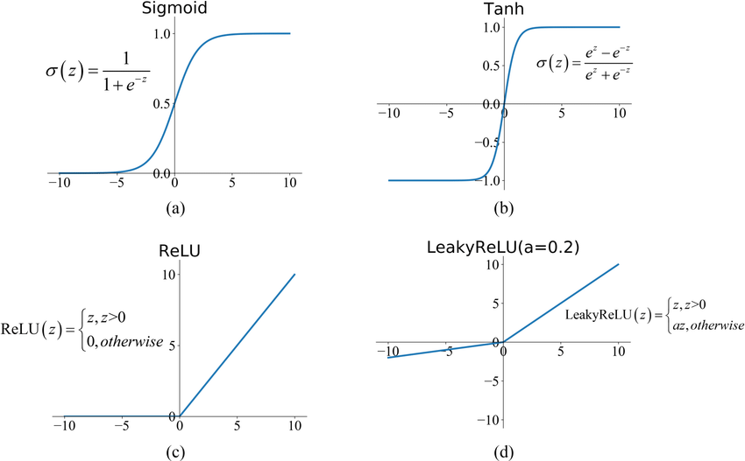
6. Challenges and research gaps:
Limited work done using neural networks primarily due to insufficient data availability.
Only basic concepts are being applied for example till now only Saha-Bora (SBAF), leaky-RELU and A-RELU.
Advanced activation functions like SoftMax, Swish and Softplus present which are yet to be explored.
The problem associated is that of vanishing gradient.

Slide 11
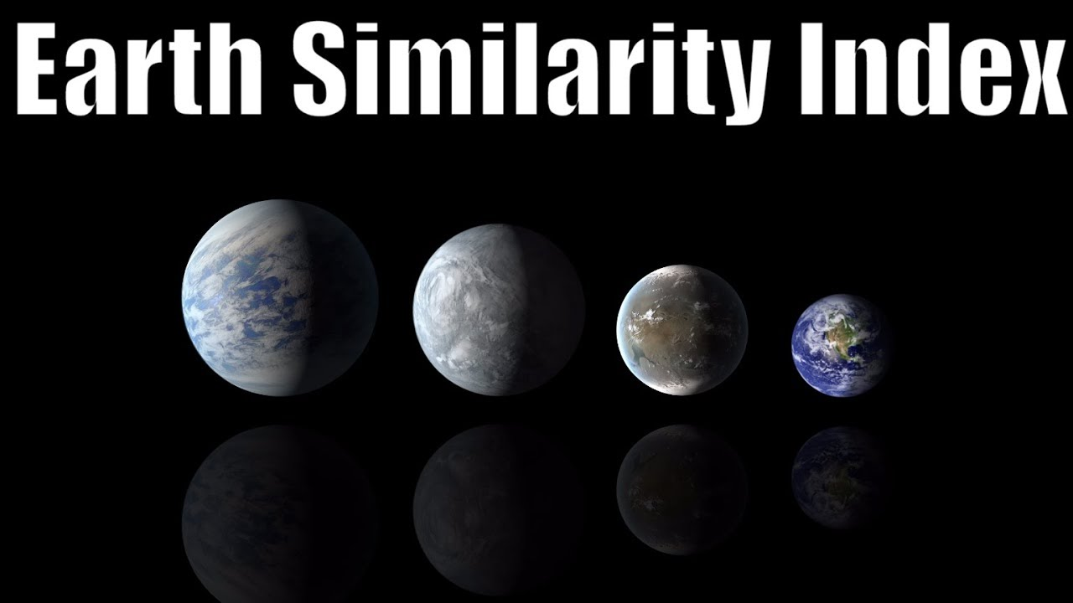
7. Problem formulation:
As our Kepler Mission itself collected a huge amount of exoplanet’s data and this volume of data will keep on increasing with future exploration missions
James Webb Space Telescope (already launched in December 2021) and PLATO (scheduled for launch in 2024).
In near future there will be explosion of data collected from these space missions and hence implementing statistical analysis on such huge datasets requires complex computational manpower. So, to tackle this problem, we came up with mixed approach of astronomy and deep learning.
In this work we will explore the advance novel activation functions along with the integration of several other ideas like optimizers and hyperparameter optimization leading to the implementation and classification of exoplanets as habitable of non-habitable.

Slide 12
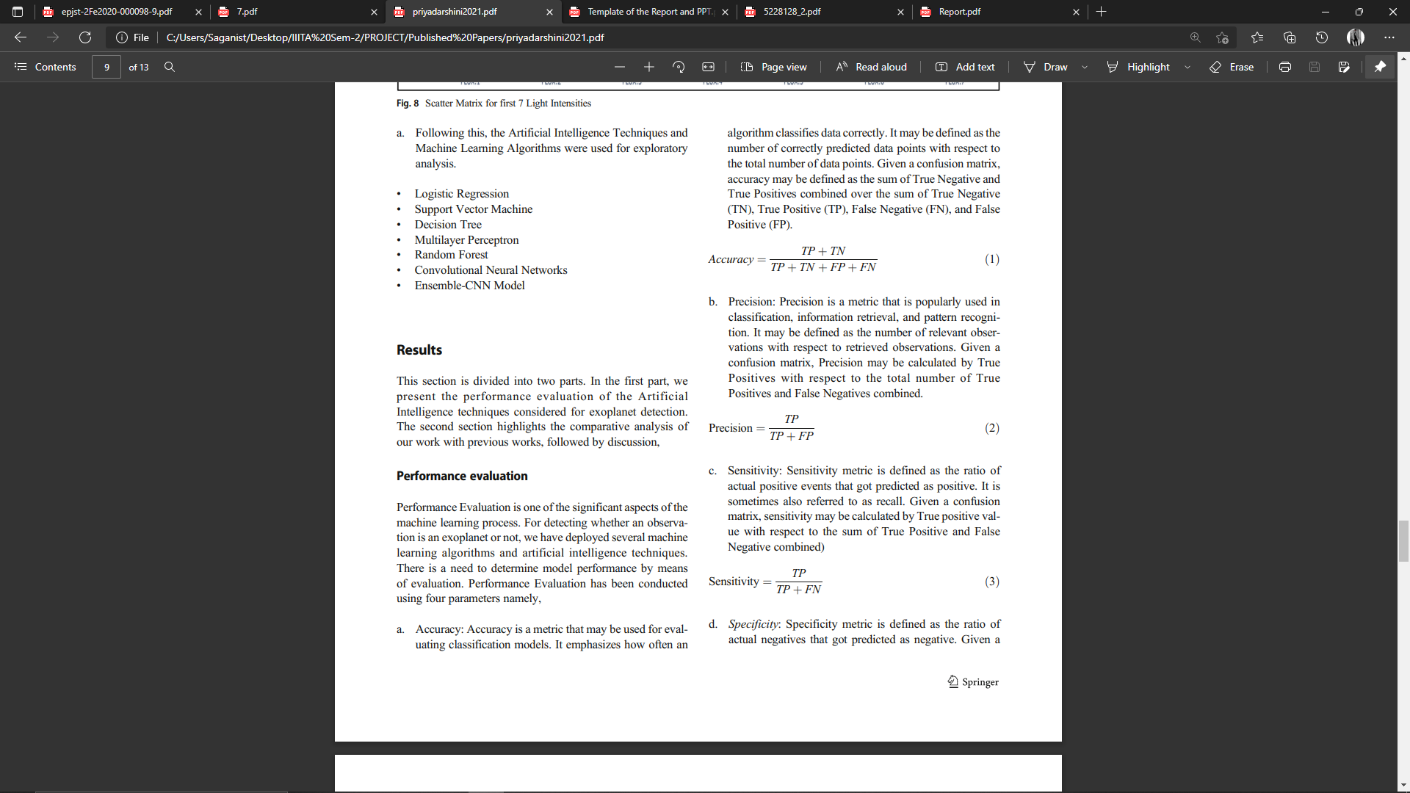
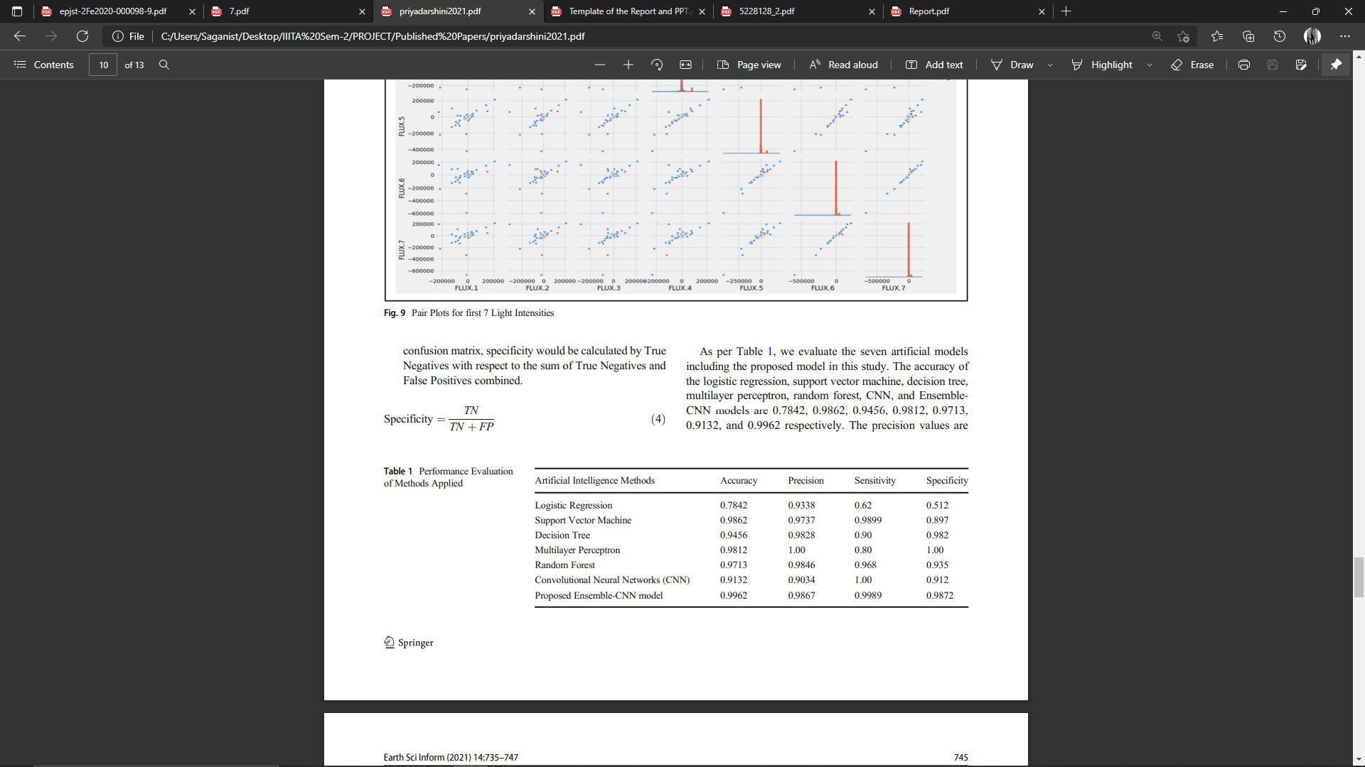
8. Expected/proposed solution:
Outcome of our proposed model will be based on four different parameters:
1. Accuracy
2. Precision
3. Sensitivity
4. Specificity

Slide 13
9. Dataset Description:
As of 25th February 2022, the current tally to total discovered exoplanet rose to 4,935.
This huge dataset of discovered extrasolar planets further have a large feature set of roughly 68 parameters.
These features can be broadly divided into two categories namely:
Categorical
Continuous
Both of these can contain two subsets of parameters namely:
Planetary features: Such as planet radius, temperature, mass, time period of rotation, time period of revolution, etc.
Stellar features: Such as star radius, mass, temperature, etc.

Slide 14
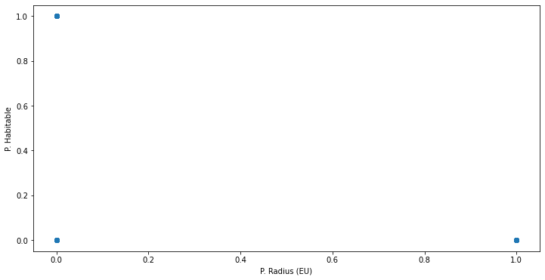
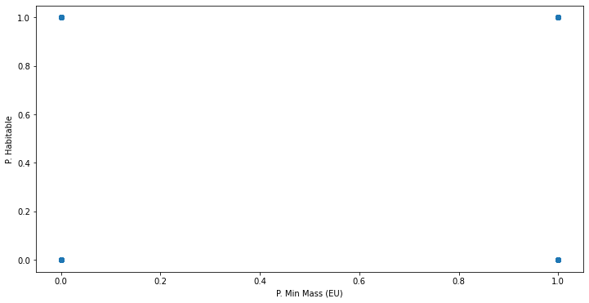
10. Data Pre-processing:
Exploratory Data Analysis (EDA):
• Missing values
• Distribution of numerical variables
• Cardinality of categorical variables
• Outliers
• Relationship between dependent and independent features

Slide 15
2. Handling Missing Values:
Deleting the missing values:
This can be achieved by either deleting the entire column or entire row consisting of missing values.
If more than 50% of the datapoints are missing for a particular feature set than we can consider deleting entire column.
Imputing missing values:
This method includes replacing the missing values with some other value namely Mean or Average of the entire feature set.

Slide 16
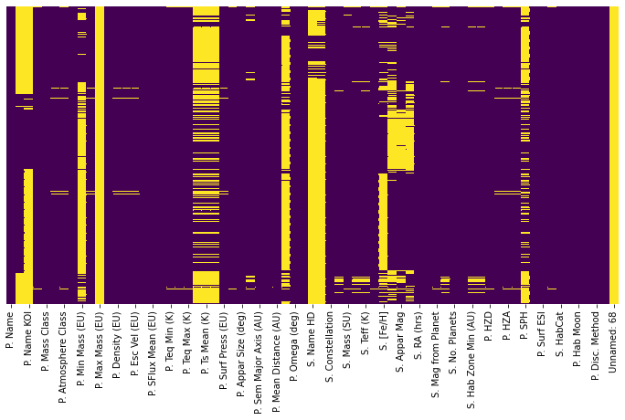
2. Handling Missing Values:

Slide 17
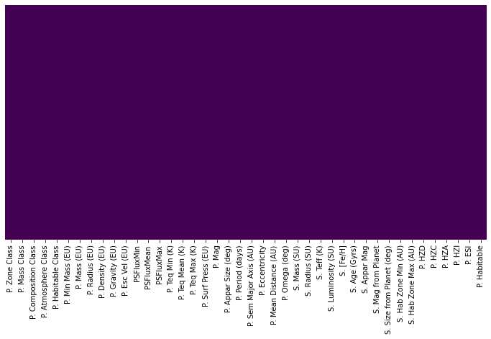
2. Handling Missing Values:

Slide 18
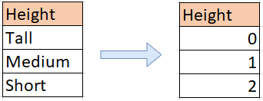
Converting categorical variables to numerical:
One Hot Encoding algorithm
Label Encoding algorithm

Slide 19
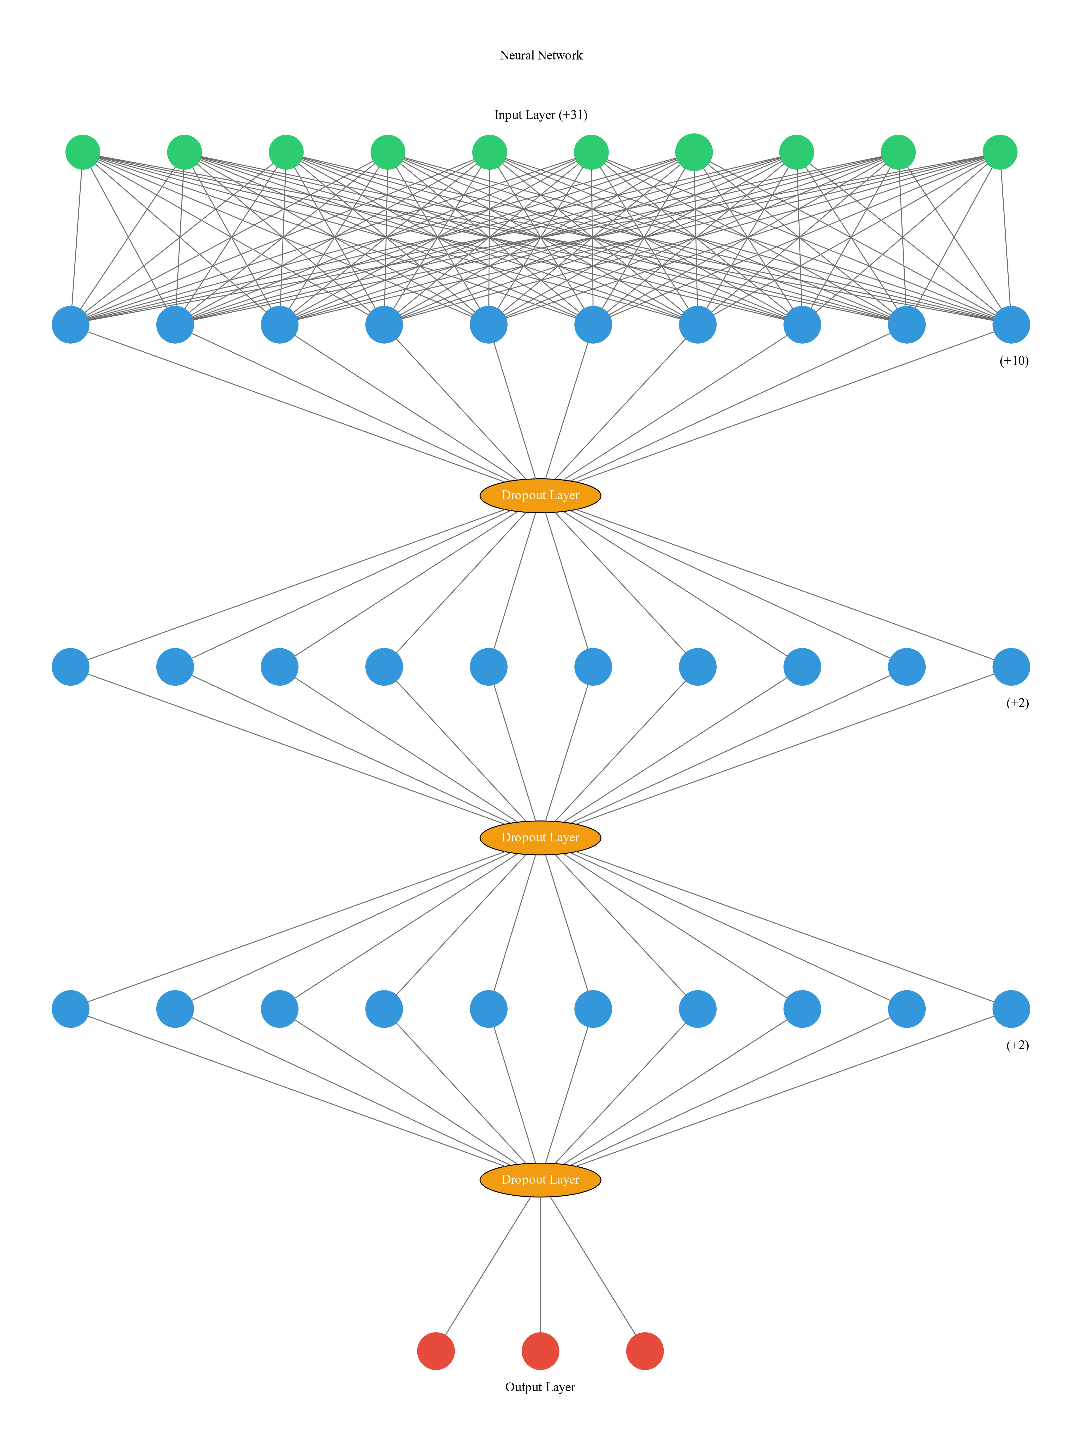
Our Neural Network:

Slide 20
11. Result:
Model 1:
3 hidden layers are used along with 1 input layer with 41 nodes and one output layer with 3 nodes.
Hidden layer 1: 20 nodes
Hidden layer 2: 12 nodes
Hidden layer 3: 12 nodes
3 dropout layers used to overcome the problem of model overfitting.
Activation function used is ReLU for hidden layers and softmax for output layer.
Optimiser used: Adamax
Batch size for training: 10
Epochs: 200
Accuracy score: 99.11

Slide 21
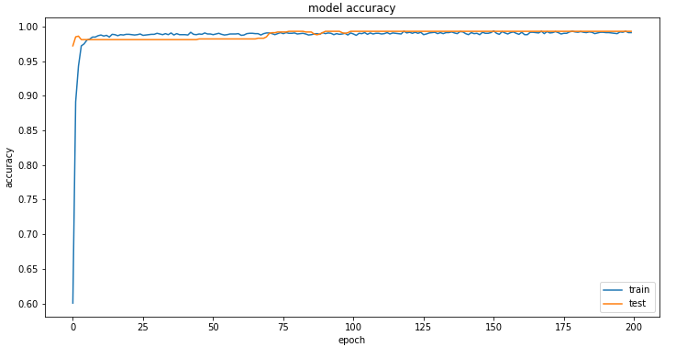
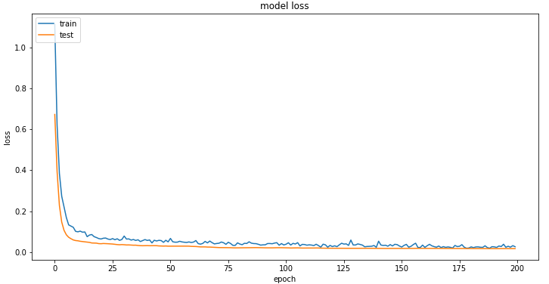
Model 1:

Slide 22
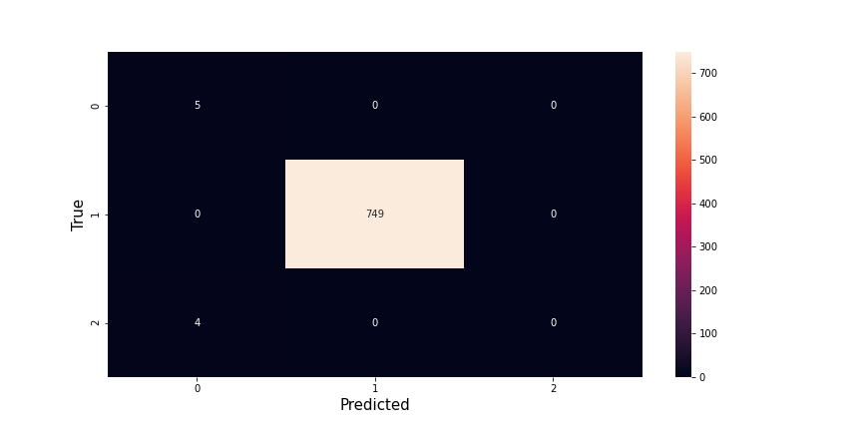
Model 1:
Heatmap of confusion matrix:

Slide 23
Model 2:
Activation function used is LeakyReLU for hidden layers and softmax for output layer.
Alpha value: 0.5
Optimiser used: Adamax
Batch size for training: 10
Epochs: 100
Accuracy score: 99.06

Slide 24
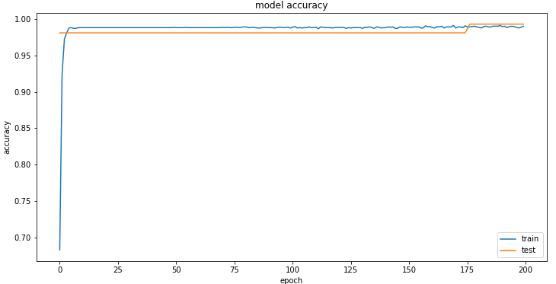
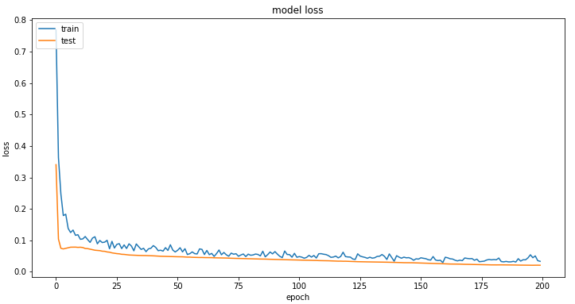
Model 2:

Slide 25
Model 2:
Heatmap of confusion matrix:

Slide 26
Model 3:
Activation function used is selu for hidden layers and softmax for output layer.
Optimiser used: Adamax
Batch size for training: 10
Epochs: 100
Accuracy score: 99.06

Slide 27
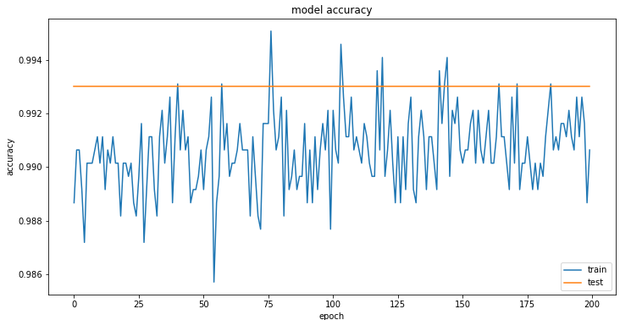
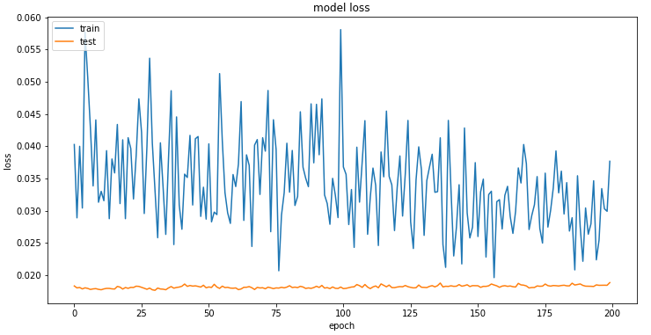
Model 3:

Slide 28
Model 3:
Heatmap of confusion matrix:

Slide 29
Metrics Score:
Accuracy score using LeakyReLU:
Accuracy score: 99.47
F1 Score using LeakyRelu:
F1 score: [0.71428571, 1. , 0. ]
Precision score using LeakyReLU:
Precision score: [0.55555556, 1. , 0. ]

Slide 30
12. Concluding remarks:
A working deep learning (Artificial Neural Network) model will be successfully created with advanced and never used before activation functions like SoftMax, Swish and Softplus and advanced optimizers like ADAGRAD and ADAM which will give much better accuracy in terms of prediction.
And also, the availability has sufficiently increased in the mean time which will also positively affect the accuracy and efficiency of our proposed model.

Slide 31
13. References:
Mishra, Rajeev. "Predicting habitable exoplanets from NASA's Kepler mission data using Machine Learning." (2017).
Hora K. (2018) Classifying Exoplanets as Potentially Habitable Using Machine Learning. In: Saini A., Nayak A., Vyas R. (eds) ICT Based Innovations. Advances in Intelligent Systems and Computing, vol 653. Springer, Singapore.
Basak, S., Saha, S., Mathur, A., Bora, K., Makhija, S., Safonova, M. and Agrawal, S., 2020. CEESA meets machine learning: A Constant Elasticity Earth Similarity Approach to habitability and classification of exoplanets. Astronomy and Computing, 30, p.100335.
Singh, S. P. . and Misra, D. K. . (2020) “Exoplanet Hunting in Deep Space with Machine Learning”, International Journal of Research in Engineering, Science and Management, 3(9), pp. 187–192. Available at: http://journals.resaim.com/ijresm/article/view/323 (Accessed: 26 February 2022).
Jagtap, R., Inamdar, U., Dere, S., Fatima, M. and Shardoor, N.B., 2021, April. Habitability of Exoplanets using Deep Learning. In 2021 IEEE International IOT, Electronics and Mechatronics Conference (IEMTRONICS) (pp. 1-6). IEEE.
Mathur, S., Sizon, S. and Goel, N., 2021. Identifying Exoplanets Using Deep Learning and Predicting Their Likelihood of Habitability. In Advances in Machine Learning and Computational Intelligence (pp. 369-379). Springer, Singapore.
Basak, S., Mathur, A., Theophilus, A.J. et al. Habitability classification of exoplanets: a machine learning insight. Eur. Phys. J. Spec. Top. 230, 2221–2251 (2021).
Priyadarshini, I., Puri, V. A convolutional neural network (CNN) based ensemble model for exoplanet detection. Earth Sci Inform 14, 735–747 (2021).
Rahman, M. and Afrin, N., 2018. Finding habitable exo planets using boosting algorithm (Doctoral dissertation, Brac University).
Saha, S., Nagaraj, N., Mathur, A. et al. Evolution of novel activation functions in neural network training for astronomy data: habitability classification of exoplanets. Eur. Phys. J. Spec. Top. 229, 2629–2738 (2020).
Mousavi-Sadr, M., Gozaliasl, G., & Jassur, D. (2021). Exoplanets prediction in multiplanetary systems. Publications of the Astronomical Society of Australia, 38, E015. doi:10.1017/pasa.2021.9

Slide 32
Thank you.

